Slide 1
LOWER LIMBS

Slide 2
LOWER LIMBS.
The Femoral Triangle
The femoral triangle is a hollow area in the anterior thigh. Many large neurovascular structures pass through this area, and can be accessed relatively easily. Thus, it is an area of both anatomical and clinical importance.

Slide 3
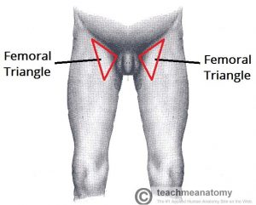

Slide 4
Borders
As this area is a triangle, it has three borders:
Superior border – Formed by the inguinal ligament, a ligament that runs from the anterior superior iliac spine to the pubic tubercle.

Slide 5
Lateral border – Formed by the medial border of the sartorius muscle.
Medial border – Formed by the medial border of the adductor longus muscle. The rest of this muscle forms part of the floor of the triangle

Slide 6
It also has a floor and a roof:
Anteriorly, the roof of the femoral triangle is formed by the fascia lata.
Posteriorly, the base of the femoral triangle is formed by the pectineus, iliopsoas and adductor longus muscles.

Slide 7
The inguinal ligament acts as a flexor retinaculum, supporting the contents of the femoral triangle during flexion at the hip

Slide 8
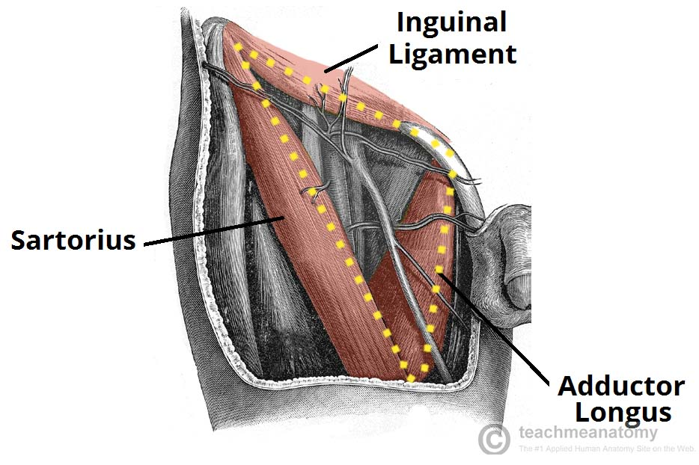

Slide 9
Contents
The femoral triangle contains some of the major neurovascular structures of the lower limb. Its contents (lateral to medial) are

Slide 10
Femoral nerve – Innervates the anterior compartment of the thigh, and provides sensory branches for the leg and foot.
Femoral artery – Responsible for the majority of the arterial supply to the lower limb.

Slide 11
Femoral vein – The great saphenous vein drains into the femoral vein within the triangle.
Femoral canal – A structure which contains deep lymph nodes and vessels.

Slide 12
The femoral artery, vein and canal are contained within a fascial compartment – known as the femoral sheath.

Slide 13
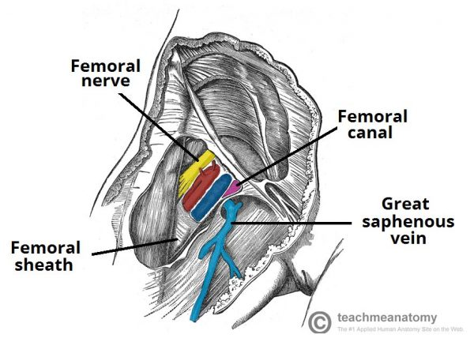
The contents of the femoral triangle

Slide 14
A good way of remembering the contents is using the acronym NAVEL:
N: Nerve. A: Artery. V: Vein. E: Empty space (this is important as it allows the veins and lymph vessels to distend, so they can cope with different levels of flow). L: Lymph canal.

Slide 15
Clinical Relevance: The Femoral Triangle
Femoral Pulse
Just inferior to where the femoral artery crosses the inguinal ligament, it can be palpated to measure the femoral pulse. The femoral artery crosses exactly midway between the pubic symphysis and anterior superior iliac spine (known as the mid-inguinal point).

Slide 16
Access to the Femoral Artery
The femoral artery is located superficially within the femoral triangle, and is thus easy to access. This makes it suitable for a range of clinical procedures.

Slide 17
One such procedure is coronary angiography. Here, the femoral artery is catheterised with a long, thin tube. This tube is navigated up the external iliac artery, common iliac artery, aorta, and into the coronary vessels. A radio-opaque dye is then injected into the coronary vessels, and any wall thickening or blockages can be visualised via x-ray.

Slide 18
Femoral Hernia
A hernia is defined as “a condition in which part of an organ is displaced and protrudes through the wall of the cavity containing it“.

Slide 19
In the case of femoral hernia, part of the bowel pushes into the femoral canal, underneath the inguinal ligament.
This manifests clinically as a lump or bulge in the area of the femoral triangle. It usually requires surgical intervention to treat.

Slide 20
The Femoral Canal
The femoral canal is an anatomical compartment located in the anterior thigh. It is the smallest and most medial part of the femoral sheath. It is approximately 1.3cm long.

Slide 21
Borders
The femoral canal is located in the anterior thigh within the femoral triangle.
It can be thought of as a rectangular shaped compartment with four borders and an opening:

Slide 22
Medial border – lacunar ligament.
Lateral border – femoral vein.
Anterior border – inguinal ligament.
Posterior border – pectineal ligament, superior ramus of the pubic bone, and the pectineus muscle

Slide 23
The opening to the femoral canal is located at its superior border, known as the femoral ring. The femoral ring is closed by a connective tissue layer – the femoral septum. This septum is pierced by the lymphatic vessels exiting the canal.

Slide 24
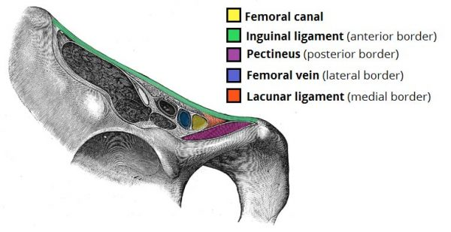
Borders of the femoral canal.

Slide 25
Contents
The femoral canal contains:
Lymphatic vessels – draining the deep inguinal lymph nodes.
Deep lymph node – the lacunar node.
Empty space.
Loose connective tissue.

Slide 26
The empty space allows distension of the adjacent femoral vein, so it can cope with increased venous return, or increased intra-abdominal pressure

Slide 28
Clinical Relevance: Femoral Hernia
The femoral canal is of particular clinical importance, as it a common site of bowel herniation.

Slide 29
A hernia is defined as ‘where an internal part of the body pushes through a weakness in the muscle or surrounding tissue wall.’ In a femoral hernia, part of the small intestine protrudes through the femoral ring.

Slide 30
It presents as a lump situated inferolateral to the pubic tubercle. This type of herniation is more common in women, due to their wider bony pelvis.

Slide 31
The borders of the femoral canal are tough, and not particularly extensible. This can compress the hernia, interfering with its blood supply. A hernia with a compromised blood supply is known as a strangulated hernia.

Slide 32
The Adductor Canal
The adductor canal (Hunter’s canal, subsartorial canal) is a narrow conical tunnel located in the thigh.

Slide 33
It is approximately 15cm long, extending from the apex of the femoral triangle to the adductor hiatus of the adductor magnus. The canal serves as a passageway from structures moving between the anterior thigh and posterior leg

Slide 34
Borders
The adductor canal is bordered by muscular structures:
Anteromedial: Sartorius.
Lateral: Vastus medialis.
Posterior: Adductor longus and adductor magnus.

Slide 35
The adductor canal runs from the apex of the femoral triangle to the adductor hiatus – a gap between the adductor and hamstring attachments of the adductor magnus muscle.

Slide 36
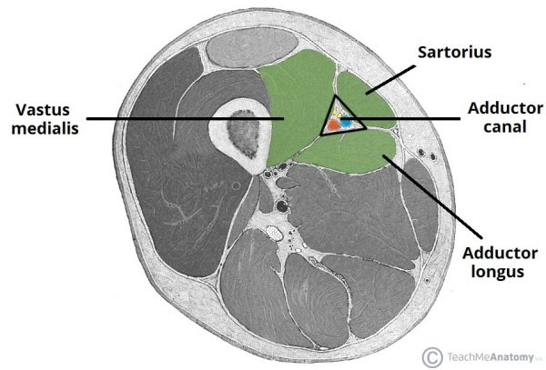
Cross-section of the thigh, showing the borders of the adductor canal

Slide 37
Contents
The adductor canal serves as a passageway for structures moving between the anterior thigh and posterior leg.

Slide 38
It transmits the femoral artery, femoral vein (posterior to the artery), nerve to the vastus medialis and the saphenous nerve – the largest cutaneous branch of the femoral nerve.

Slide 39
As the femoral artery and vein exit the canal, they are called the popliteal artery and vein respectively.

Slide 40
Clinical Relevance - Adductor Canal Block
In the adductor canal block, local anaesthetic is administered in the adductor canal to block the saphenous nerve in isolation, or together with the nerve to the vastus medialis.

Slide 41
The block can be used to provide sensory anaesthesia for procedures involving the distal thigh and femur, knee and lower leg on the medial side. The sartorius and femoral artery are used as anatomical landmarks to locate the saphenous nerve

Slide 42
Clinical Relevance - Adductor Canal Compression Syndrome
Adductor canal compression syndrome describes entrapment of the neurovascular bundle within the adductor canal. A rare condition, it is usually caused by hypertrophy of adjacent muscles such as vastus medialis.

Slide 43
It is most common in young males, who may present with claudication symptoms due to femoral artery occlusion (more common) or neurological symptoms due to entrapment of the saphenous nerve.

Slide 44
The Popliteal Fossa
The popliteal fossa is a diamond shaped area located on the posterior aspect of the knee. It is the main path by which vessels and nerves pass between the thigh and the leg.

Slide 45
Borders
The popliteal fossa is diamond shaped with four borders. These borders are formed by the muscles in the posterior compartment of the leg and thigh:
Superomedial border – semimembranosus.
Superolateral border – biceps femoris.

Slide 46
Inferomedial border – medial head of the gastrocnemius.
Inferolateral border – lateral head of the gastrocnemius and plantaris

Slide 47
The popliteal fossa also has a floor and a roof. The floor is formed by the posterior surface of the knee joint capsule and by the posterior surface of the femur. The roof is made of up two layers; popliteal fascia and skin. The popliteal fascia is continuous with the fascia lata of the leg.

Slide 48
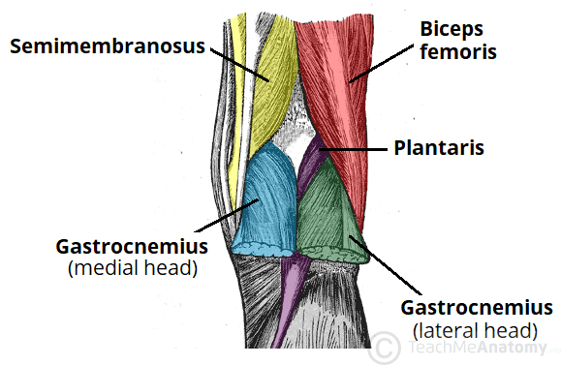

Slide 49
Contents
The popliteal fossa is the main conduit for neurovascular structures entering and leaving the leg. Its contents are (medial to lateral):
Popliteal artery
Popliteal vein
Tibial nerve
Common fibular nerve (common peroneal nerve)

Slide 50
The tibial and common fibular nerves are the most superficial of the contents of the popliteal fossa. They are both branches of the sciatic nerve. The common fibular nerve follows the biceps femoris tendon, travelling along the lateral margin of the popliteal fossa.

Slide 51
The small saphenous vein pierces the popliteal fascia of the popliteal fossa to enter the diamond, and empty into the popliteal vein.
In the popliteal fossa, the deepest structure is the popliteal artery. It is a continuation of the femoral artery, and travels into the leg to supply it with blood

Slide 52
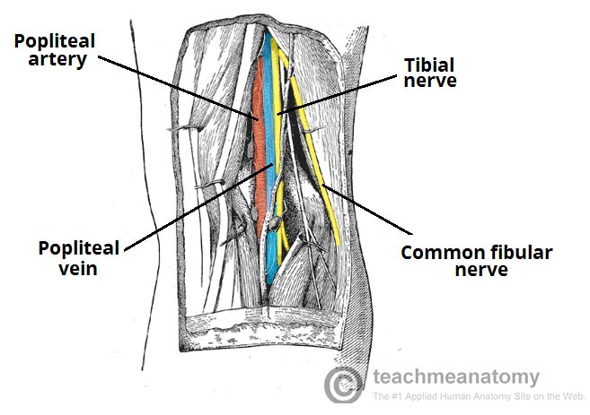

Slide 53
Clinical Relevance: Swelling in the Popliteal Fossa
The appearance of a mass in the popliteal fossa has many differential diagnoses. The two major causes are baker’s cyst and aneurysm of the popliteal artery.
Baker’s Cyst

Slide 54
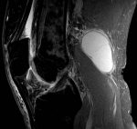
MRI Scan of a Baker’s cyst.

Slide 55
A baker’s cyst (or popliteal cyst) refers to the inflammation and swelling of the semimembranosus bursa – a fluid filled sac found in the knee joint. They usually arise in conjunction with arthritis of the knee (rheumatoid or osteoarthritis). Whilst it usually self-resolves, the cyst can rupture and produce symptoms similar to deep vein thrombosis.

Slide 56
Popliteal Aneurysm
An aneurysm is a dilation of an artery, which is greater than 50% of the normal diameter. The popliteal fascia (the roof of the popliteal fossa) is tough and non-extensible, and so an aneurysm of the popliteal artery has consequences for the other contents of the popliteal fossa.

Slide 57
The tibial nerve is particularly susceptible to compression from the popliteal artery. The major features of tibial nerve compression are:
Weakened or absent plantar flexion

Slide 58
Paraesthesia of the foot and posterolateral leg
An aneurysm of the popliteal artery can be detected by an obvious palpable pulsation in the popliteal fossa. An arterial bruit may be heard on auscultation

Slide 59
FACIA
Fascia is a sheet or band of fibrous tissue lying deep to the skin. It lines, invests, and separates structures within the body. There are three main types of fascia:

Slide 60
Superficial fascia – blends with the reticular layer beneath the dermis.
Deep fascia – envelopes muscles, bones, and neurovascular structures.
Visceral fascia – provides membranous investments that suspend organs within their cavities

Slide 61
Anatomical Structure
The fascia lata is a deep fascial investment of the musculature of the thigh, and is analogous to a strong, extensible, and elasticated stocking.

Slide 62
It begins proximally around the iliac crest and inguinal ligament, and ends distal to the bony prominences of the tibia. It is continuous with what is renamed the deep fascia of the leg (also known as the crural fascia

Slide 63
. It is thickest along the superolateral aspect of the thigh, where it arises from the fascial condensations of gluteus maximus and medius.

Slide 64
It is also thick around the knee where the fascia receives reinforcing fibres from tendons of the quadriceps muscles.
The fascial investment is thinnest where it covers the adductor muscles of the medial thigh.

Slide 65
An ovoid hiatus known as the saphenous opening is present in the fascia lata just inferior to the inguinal ligament.

Slide 66
The opening serves as an entry point for efferent lymphatic vessels and the great saphenous vein, draining into superficial inguinal lymph nodes and the femoral vein respectively.

Slide 67
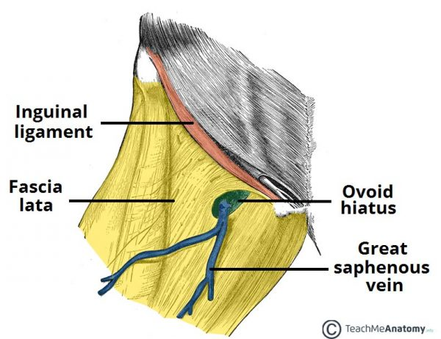

Slide 68
Clinical Significance: Femoral Hernia
A femoral hernia develops when an out-pouching of abdominal viscera protrudes through the femoral canal. The protrusion becomes noticeable when it exits superficially through the saphenous opening within the fascia lata – producing a swelling inferior to the inguinal ligament.

Slide 69
The saphenous opening is relatively small, and the surrounding fascia lata is quite tight and inflexible, so femoral hernias carry high risk of bowel incarceration or strangulation, which requires rapid surgical intervention.

Slide 70
Anatomical Relations
Iliotibial Tract (ITT)
The iliotibial tract (sometimes known as the iliotibial band or IT band) is a longitudinal thickening of the fascia lata, which is strengthened superoposteriorly by fibres from the gluteus maximus

Slide 71
It is located laterally in the thigh, extending from the iliac tubercle to the lateral tibial condyle. The ITT has three main functions:
Movement – acts as an extensor, abductor and lateral rotator of the hip, with an additional role in providing lateral stabilisation to the knee joint.

Slide 72
Compartmentalisation – the deepest aspect of ITT extends centrally to form the lateral intermuscular septum of the thigh and attaches to the femur.
Muscular sheath – forms a sheath around the tensor fascia lata muscle

Slide 73
Tensor Fascia Lata (TFL)
The tensor fascia lata is a gluteal muscle that acts as a flexor, abductor, and internal rotator of the hip.

Slide 74
Its name, however, is derived from its additional role in tensing the fascia lata. It is innervated by the superior gluteal nerve, like gluteus medius and minimus, but is located more anterolaterally than the other gluteal muscles.

Slide 75
The muscle originates from the iliac crest, and descends inferiorly to the superolateral thigh. At the junction of the middle and upper thirds of the thigh, it inserts into the anterior aspect of the iliotibial tract.

Slide 76
Fascia lata also makes muscle contraction more efficient in compressing deep veins, which ensures adequate venous return to the heart from the lower limbs.

Slide 77
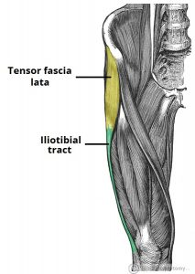

Slide 78
Clinical Significance: Transplantation
Dermatofasciotomy and debridement can leave large wound sites that require post-operative grafts to facilitate tissue regeneration and healing.

Slide 79
The fascia lata graft is a popular choice as the iliotibial tract provides a particularly high concentration of connective tissue fibres, and can be surgically harvested whilst leaving the majority of fibres intact.

Slide 80
Novel developments in transplantation have also shown success with using fascia lata in reconstructive

Slide 81
Muscles of the Gluteal Region
The gluteal region is an anatomical area located posteriorly to the pelvic girdle, at the proximal end of the femur. The muscles in this region move the lower limb at the hip joint.

Slide 82
The muscles of the gluteal region can be broadly divided into two groups:
Superficial abductors and extenders – group of large muscles that abduct and extend the femur. Includes the gluteus maximus, gluteus medius, gluteus minimus and tensor fascia lata.

Slide 83
Deep lateral rotators – group of smaller muscles that mainly act to laterally rotate the femur. Includes the quadratus femoris, piriformis, gemellus superior, gemellus inferior and obturator internus.

Slide 84
The arterial supply to these muscles is mostly via the superior and inferior gluteal arteries – branches of the internal iliac artery. Venous drainage follows the arterial supply.

Slide 85
The Superficial Muscles
The superficial muscles in the gluteal region consist of the three glutei and the tensor fascia lata. They mainly act to abduct and extend the lower limb at the hip joint.

Slide 86
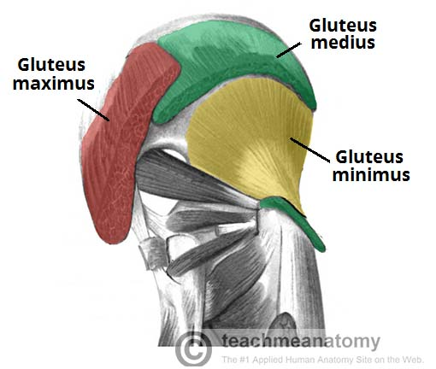
Gluteus Maximus

Slide 87
The gluteus maximus is the largest of the gluteal muscles. It is also the most superficial, producing the shape of the buttocks.

Slide 88
Attachments: Originates from the gluteal (posterior) surface of the ilium, sacrum and coccyx. It slopes across the buttock at a 45 degree angle, then inserts into the iliotibial tract and the gluteal tuberosity of the femur.

Slide 89
Actions: It is the main extensor of the thigh, and assists with lateral rotation. However, it is only used when force is required, such as running or climbing.
Innervation: Inferior gluteal nerve.

Slide 90
Gluteus Medius
The gluteus medius muscle is fan-shaped and lies between to the gluteus maximus and the minimus. It is similar in shape and function to the gluteus minimus.
Attachments: Originates from the gluteal surface of the ilium and inserts into the lateral surface of the greater trochanter.

Slide 91
Actions: Abducts and medially rotates the lower limb. During locomotion, it secures the pelvis, preventing pelvic drop of the opposite limb.
Innervation: Superior gluteal nerve.

Slide 92
Gluteus Minimus
The gluteus minimus is the deepest and smallest of the superficial gluteal muscles. It is similar is shape and function to the gluteus medius.
Attachments: Originates from the ilium and converges to form a tendon, inserting to the anterior side of the greater trochanter.

Slide 93
Actions: Abducts and medially rotates the lower limb. During locomotion, it secures the pelvis, preventing pelvic drop of the opposite limb.
Innervation: Superior gluteal nerve.

Slide 94
Tensor Fascia Lata
Tensor fasciae lata is a small superficial muscle which lies towards the anterior edge of the iliac crest. It functions to tighten the fascia lata, and so abducts and medially rotates the lower limb.
Attachments: Originates from the anterior iliac crest, attaching to the anterior superior iliac spine (ASIS). It inserts into the iliotibial tract, which itself attaches to the lateral condyle of the tibia.

Slide 95
Actions: Assists the gluteus medius and minimus in abduction and medial rotation of the lower limb. It also plays a supportive role in the gait cycle.
Innervation: Superior gluteal nerve.

Slide 96
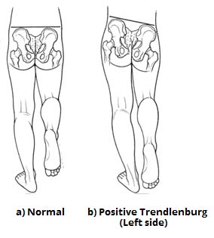
Clinical Relevance: Damage to the Superior Gluteal Nerve
Positive Trendelenburg sign, characteristic of left superior gluteal nerve palsy

Slide 97
The superior gluteal nerve innervates the gluteus medius and the gluteus minimus. These muscles have an important role in stabilising the pelvis during locomotion. In the standing position, the gluteus minimus and medius contract when the contralateral leg is raised, preventing the pelvis from dropping on that side.

Slide 98
If the superior gluteal nerve is damaged, the previously described muscles are paralysed – and the pelvis becomes unsteady. A characteristic finding of gluteal muscle weakness is the Trendelenburg sign.

Slide 99
Trendelenburg Sign
The Trendelenburg sign is produced when the patient is asked to stand unassisted on each leg in turn. In a positive sign, pelvic drop will occur on the unsupported leg. Pelvic drop can be recognised by observing the level of the iliac crests on both sides.

Slide 100
The Deep Muscles
The deep gluteal muscles are a set of smaller muscles, located underneath the gluteus minimus. The general action of these muscles is to laterally rotate the lower limb. They also stabilise the hip joint by ‘pulling’ the femoral head into the acetabulum of the pelvis.

Slide 101
Piriformis
The piriformis muscle is a key landmark in the gluteal region. It is the most superior of the deep muscles.
Attachments: Originates from the anterior surface of the sacrum. It then travels infero-laterally, through the greater sciatic foramen, to insert into the greater trochanter of the femur.

Slide 102
Actions: Lateral rotation and abduction.
Innervation: Nerve to piriformis.

Slide 103
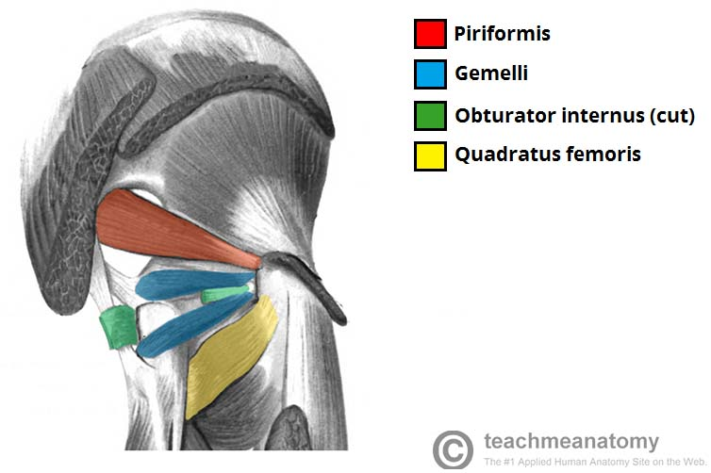
Obturator Internus
The deep muscles of the gluteal region

Slide 104
The obturator internus forms the lateral walls of the pelvic cavity. In some texts, the obturator internus and the gemelli muscles are considered as one muscle – the triceps coxae.

Slide 105
Attachments: Originates from the pubis and ischium at the obturator foramen. It travels through the lesser sciatic foramen, and attaches to the greater trochanter of the femur.
Actions: Lateral rotation and abduction.
Innervation: Nerve to obturator internus.

Slide 106
The Gemelli – Superior and Inferior
The gemelli are two narrow and triangular muscles. They are separated by the obturator internus tendon.
Attachments: The superior gemellus muscle originates from the ischial spine, the inferior from the ischial tuberosity. They both attach to the greater trochanter of the femur.

Slide 107
Actions: Lateral rotation and abduction.
Innervation: The superior gemellus muscle is innervated by the nerve to obturator internus, the inferior gemellus is innervated by the nerve to quadratus femoris.

Slide 108
Quadratus Femoris
The quadratus femoris is a flat, square-shaped muscle. It is the most inferior of the deep gluteal muscles, located below the gemelli and obturator internus.
Attachments: It originates from the lateral side of the ischial tuberosity, and attaches to the quadrate tuberosity on the intertrochanteric crest.

Slide 109
Actions: Lateral rotation.
Innervation: Nerve to quadratus femoris.

Slide 110
Innervation: Nerve to quadratus femoris.
Clinical Relevance: Landmark of the Gluteal Region
The piriformis is an important anatomical landmark in the gluteal region.

Slide 111
As the muscle travels through the greater sciatic foramen, it effectively divides the gluteal region into an inferior and superior part.

Slide 112
This division determines the name of the vessels and nerves that supply the area. The superior gluteal nerve and vessels emerge into the gluteal region superiorly to the piriformis (and vice versa for the inferior gluteal nerve).

Slide 113
In addition, the piriformis can be used to locate the sciatic nerve (a major peripheral nerve of the lower limb). The sciatic nerve enters the gluteal region directly inferior to the piriformis, and is visible as a flat band, approximately 2cm wide.

Slide 114
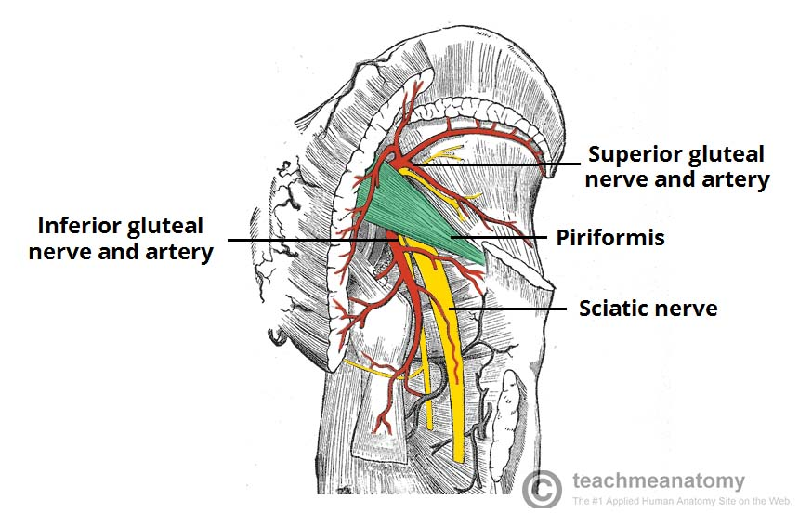
– The piriformis as an anatomical landmark in the gluteal region

Slide 115
Muscles in the Anterior Compartment of the Thigh
The musculature of the thigh can be split into three sections; anterior, medial and posterior. Each compartment has a distinct innervation and function.

Slide 116
The muscles in the anterior compartment of the thigh are innervated by the femoral nerve (L2-L4), and as a general rule, act to extend the leg at the knee joint.

Slide 117
There are three major muscles in the anterior thigh – the pectineus, sartorius and quadriceps femoris. In addition to these, the end of the iliopsoas muscle passes into the anterior compartment.

Slide 118
Iliopsoas
The iliopsoas is actually two muscles, the psoas major and the iliacus. They originate in different areas, but come together to form a tendon, hence why they are commonly referred to as one muscle.

Slide 119
Unlike many of the anterior thigh muscles, the iliopsoas does not extend the leg at the knee joint
Attachments: The psoas major originates from the lumbar vertebrae, and the iliacus originates from the iliac fossa of the pelvis. They insert together onto the lesser trochanter of the femur.

Slide 120
Actions: Flexes the thigh at the hip joint.
Innervation: The psoas major is innervated by anterior rami of L1-3, while the iliacus is innervated by the femoral nerve.

Slide 121
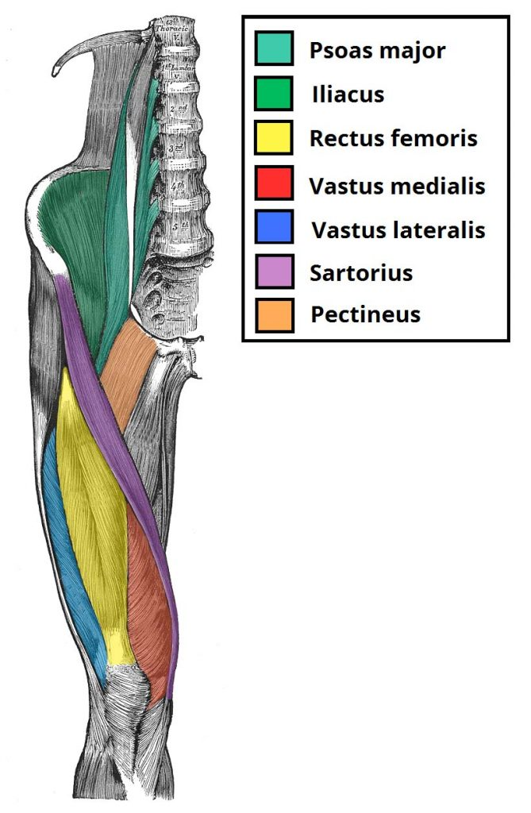
– The muscles of the anterior thigh

Slide 122
Quadriceps Femoris
The quadriceps femoris consists of four individual muscles; three vastus muscles and the rectus femoris. They form the main bulk of the thigh, and collectively are one of the most powerful muscles in the body.

Slide 123
The muscles that form the quadriceps femoris unite proximal to the knee and attach to the patella via the quadriceps tendon. In turn, the patella is attached to the tibia by the patella ligament. The quadriceps femoris is the main extensor of the knee.

Slide 124
Vastus Lateralis
Proximal attachment: Originates from the greater trochanter and the lateral lip of linea aspera.
Actions: Extends the knee joint and stabilises the patella.
Innervation: Femoral nerve.

Slide 125
Vastus Intermedius
Proximal attachment: Anterior and lateral surfaces of the femoral shaft.
Actions: Extends the knee joint and stabilises the patella.
Innervation: Femoral nerve.

Slide 126
Vastus Medialis
Proximal attachment: The intertrochanteric line and medial lip of the linea aspera.
Actions: Extends the knee joint and stabilises the patella, particularly due to its horizontal fibres at the distal end.
Innervation: Femoral nerve

Slide 127
Rectus Femoris
Attachments: Originates from the ilium, just superior to the acetabulum. It runs straight down the leg (the Latin for straight is rectus), and attaches to the patella by the quadriceps femoris tendon.

Slide 128
Actions: The only muscle of the quadriceps to cross both the hip and knee joints. It flexes the thigh at the hip joint, and extends at the knee joint.
Innervation: Femoral nerve.

Slide 129
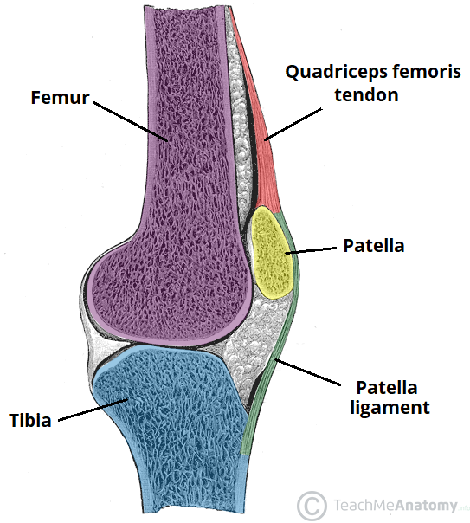
The femur, tibia and patella of the knee joint

Slide 130
Sartorius
The sartorius is the longest muscle in the body. It is long and thin, running across the thigh in a inferomedial direction. The sartorius is positioned more superficially than the other muscles in the leg.

Slide 131
Attachments: Originates from the anterior superior iliac spine, and attaches to the superior, medial surface of the tibia.
Actions: At the hip joint, it is a flexor, abductor and lateral rotator. At the knee joint, it is also a flexor.
Innervation: Femoral nerve

Slide 132
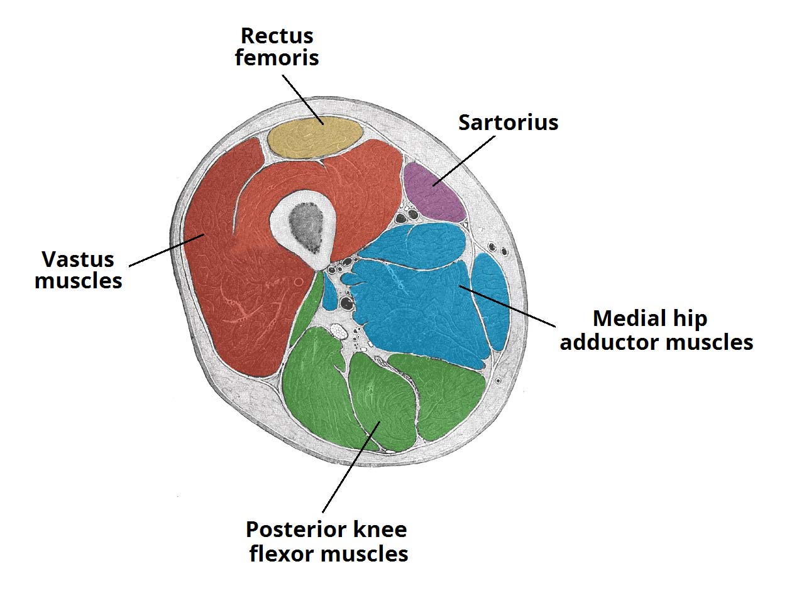
Cross section of the distal thigh

Slide 133
Pectineus
The pectineus muscle is a flat muscle that forms the base of the femoral triangle. It has a dual innervation, and thus can be considered a transitional muscle between the anterior thigh and medial thigh compartments.

Slide 134
Attachments: It originates from the pectineal line on the anterior surface of the pelvis, and attaches to the pectineal line on the posterior side of the femur, just inferior to the lesser trochanter.
Actions: Adduction and flexion at the hip joint.
Innervation: Femoral nerve. May also receive a branch from the obturator nerve.

Slide 135
Clinical Relevance: Testing the Quadriceps Femoris
The quadriceps femoris muscle can be used to test the femoral nerve in cases of suspected nerve palsy.

Slide 136
This is performed by positioning the patient supine, with the knee slightly flexed. The patient is asked to extend the leg (at the knee) against resistance. If the femoral nerve is damaged, contraction of the quadriceps femoris will be absent.

Slide 137
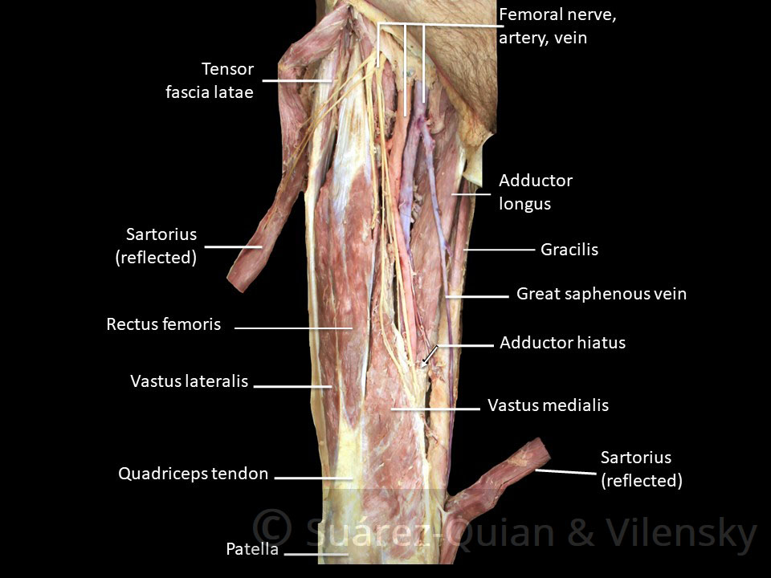
The muscles of the anterior thigh

Slide 138
Muscles in the Posterior Compartment of the Thigh
The muscles in the posterior compartment of the thigh are collectively known as the hamstrings. They consist of the biceps femoris, semitendinosus and semimembranosus, which form prominent tendons medially and laterally at the back of the knee.

Slide 139
As group, these muscles act to extend at the hip, and flex at the knee. They are innervated by the sciatic nerve (L4-S3).

Slide 140
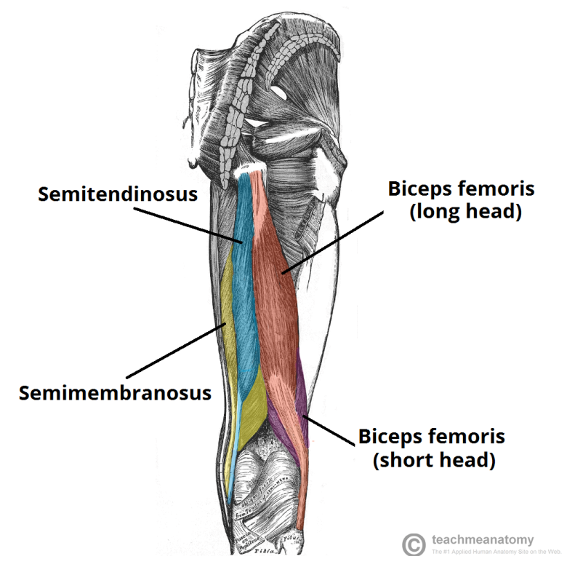
Biceps Femoris
The muscles of the posterior thigh (right

Slide 141
Attachments: The long head originates from the ischial tuberosity of the pelvis. The short head originates from the linea aspera on posterior surface of the femur. Together, the heads form a tendon, which inserts into the head of the fibula.

Slide 142
Like the biceps brachii in the arm, the biceps femoris muscle has two heads – a long head and a short head.
It is the most lateral of the muscles in the posterior thigh – the common tendon of the two heads can be felt laterally at the posterior knee.

Slide 143
Actions: Main action is flexion at the knee. It also extends the thigh at the hip, and laterally rotates at the hip and knee.
Innervation: Long head innervated by the tibial part of the sciatic nerve, whereas the short head is innervated by the common fibular part of the sciatic nerve.

Slide 144
Semitendinosus
The semitendinosus is a largely tendinous muscle. It lies medially to the biceps femoris, and covers the majority of the semimembranosus.
Attachments: It originates from the ischial tuberosity of the pelvis, and attaches to the medial surface of the tibia.

Slide 145
Actions: Flexion of the leg at the knee joint. Extension of thigh at the hip. Medially rotates the thigh at the hip joint and the leg at the knee joint.
Innervation: Tibial part of the sciatic nerve.

Slide 146
Semimembranosus
The semimembranosus muscle is flattened and broad. It is located underneath the semitendinosus.
Attachments: It originates from the ischial tuberosity, but does so more superiorly than the semitendinosus and biceps femoris. It attaches to the medial tibial condyle.

Slide 147
Actions: Flexion of the leg at the knee joint. Extension of thigh at the hip. Medially rotates the thigh at the hip joint and the leg at the knee joint.
Innervation: Tibial part of the sciatic nerve.

Slide 148
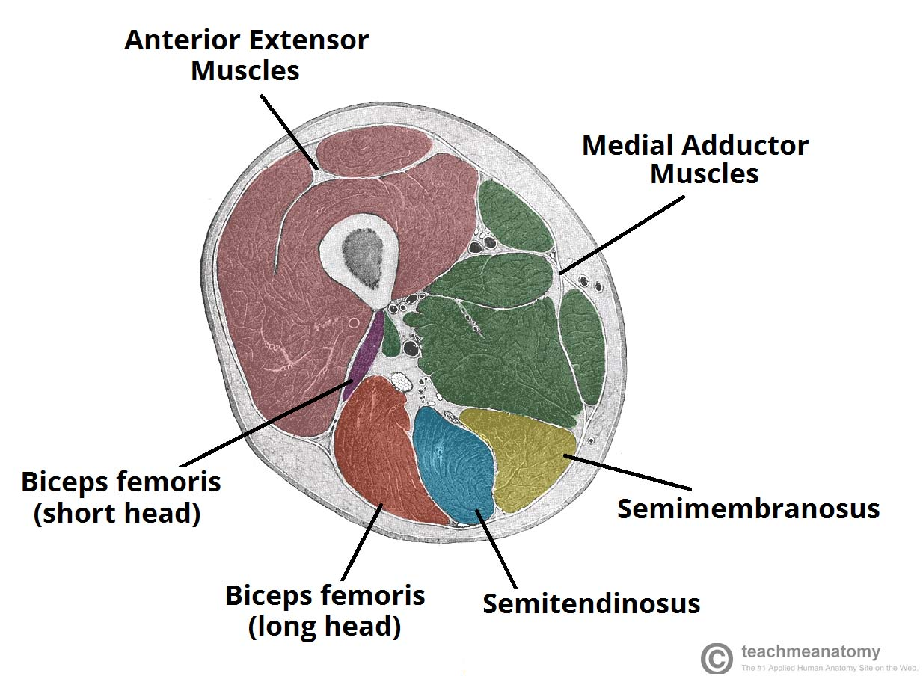
A cross section of the left thigh

Slide 149
Clinical Relevance: Damage to the Hamstrings
Muscle Strain
A hamstring strain refers to excessive stretch or tearing of the muscle fibres. They are often seen athletes involved in running or kicking sports.

Slide 150
Damage to the muscle fibres is likely to rupture the surrounding blood vessels – producing a haematoma (a collection of blood). The haematoma is contained by the overlying fascia lata.
Treatment of any muscle strain should utilise the RICE protocol – rest, ice, compression and elevation.

Slide 151
Avulsion Fracture of the Ischial Tuberosity
An avulsion fracture occurs when a fragment of bone breaks away from the main body of bone.
In an avulsion fracture of the ischial tuberosity, the hamstring tendons ‘tear off’ a piece of the ischial tuberosity. Such an injury usually occurs in sports that require rapid contraction and relaxation of the muscles – such as sprinting, football and hurdling.

Slide 152
Muscles in the Medial Compartment of the Thigh
The muscles in the medial compartment of the thigh are collectively known as the hip adductors. There are five muscles in this group; gracilis, obturator externus, adductor brevis, adductor longus and adductor magnus.

Slide 153
All the medial thigh muscles are innervated by the obturator nerve, which arises from the lumbar plexus. Arterial supply is via the obturator artery.

Slide 154
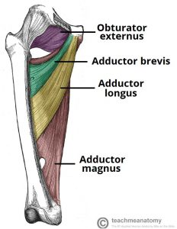
Muscles of the Medial Thigh Adductor Magnus

Slide 155
The adductor magnus is the largest muscle in the medial compartment. It lies posteriorly to the other muscles.

Slide 156
Functionally, the muscle can be divided into two parts; the adductor part, and the hamstring part.
Attachments
Adductor part – Originates from the inferior rami of the pubis and the rami of ischium, attaching to the linea aspera of the femur.

Slide 157
Hamstring part – Originates from the ischial tuberosity and attaches to the adductor tubercle and medial supracondylar line of the femur.

Slide 158
Actions: They both adduct the thigh. The adductor component also flexes the thigh, with the hamstring portion extending the thigh.
Innervation: Adductor part is innervated by the obturator nerve (L2-L4), the hamstring part is innervated by the tibial component of the sciatic nerve (L4-S3).

Slide 159
Adductor Longus
The adductor longus is a large, flat muscle. It partially covers the adductor brevis and magnus. The muscle forms the medial border of the femoral triangle.

Slide 160
Attachments: Originates from the pubis, and expands into a fan shape, attaching broadly to the linea aspera of the femur
Actions: Adduction of the thigh.
Innervation: Obturator nerve (L2-L4).

Slide 161
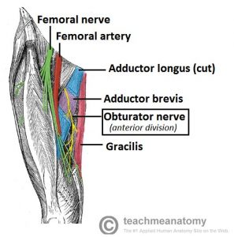
Adductor Brevis

Slide 162
The adductor brevis is a short muscle, lying underneath the adductor longus.
It lies in between the anterior and posterior divisions of the obturator nerve. Therefore, it can be used as an anatomical landmark to identify the branches of the above nerve.

Slide 163
Attachments: Originates from the body of pubis and inferior pubic rami. It attaches to the linea aspera on the posterior surface of the femur, proximal to the adductor longus.
Actions: Adduction of the thigh.
Innervation: Obturator nerve (L2-L4).

Slide 164
Obturator Externus
This is one of the smaller muscles of the medial thigh, and it is located most superiorly.
Attachments: It originates from the membrane of the obturator foramen, and adjacent bone. It passes under the neck of femur, attaching to the posterior aspect of the greater trochanter.

Slide 165
Actions: Adduction and lateral rotation of the thigh.
Innervation: Obturator nerve (L2-L4).

Slide 166
Gracilis
The gracilis is the most superficial and medial of the muscles in this compartment. It crosses at both the hip and knee joints. It is sometimes transplanted into the hand or forearm to replace a damaged muscle.

Slide 167
Attachments: It originates from the inferior rami of the pubis, and the body of the pubis. Descending almost vertically down the leg, it attaches to the medial surface of the tibia, between the tendons of the sartorius (anteriorly) and the semitendinosus (posteriorly).

Slide 168
Actions: Adduction of the thigh at the hip, and flexion of the leg at the knee.
Innervation: Obturator nerve (L2-L4).

Slide 169
Muscles in the Anterior Compartment of the Leg
There are four muscles in the anterior compartment of the leg; tibialis anterior, extensor digitorum longus, extensor hallucis longus and fibularis tertius.

Slide 170
Collectively, they act to dorsiflex and invert the foot at the ankle joint. The extensor digitorum longus and extensor hallucis longus also extend the toes.

Slide 171
The muscles in this compartment are innervated by the deep fibular nerve (L4-S1), and blood is supplied via the anterior tibial artery.

Slide 172
Tibialis Anterior
The tibialis anterior muscle is located alongside the lateral surface of the tibia.
It is the strongest dorsiflexor of the foot.
To test the power of the tibialis anterior, the patient can be asked to stand on their heels.

Slide 173
Attachments: Originates from the lateral surface of the tibia, attaches to the medial cuneiform and the base of metatarsal I.
Actions: Dorsiflexion and inversion of the foot.
Innervation: Deep fibular nerve.

Slide 174
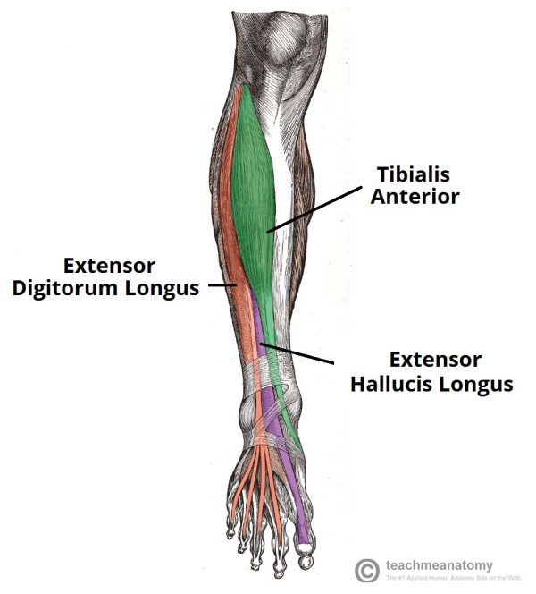
The muscles of the anterior leg.

Slide 175
Extensor Digitorum Longus
The extensor digitorum longus lies lateral and deep to the tibialis anterior. The tendons of the EDL can be palpated on the dorsal surface of the foot.

Slide 176
Attachments: Originates from the lateral condyle of the tibia and the medial surface of the fibula. The fibres converge into a tendon, which travels to the dorsal surface of the foot. The tendon splits into four, each inserting onto a toe.

Slide 177
Actions: Extension of the lateral four toes, and dorsiflexion of the foot.
Innervation: Deep fibular nerve.

Slide 178
Extensor Hallucis Longus
The extensor hallucis longus is located deep to the EDL and TA.
Attachments: Originates from the medial surface of the fibular shaft. The tendon crosses anterior to the ankle joint and attaches to the base of the distal phalanx of the great toe.

Slide 179
Action: Extension of the great toe and dorsiflexion of the foot.
Innervation: Deep fibular nerve.

Slide 180
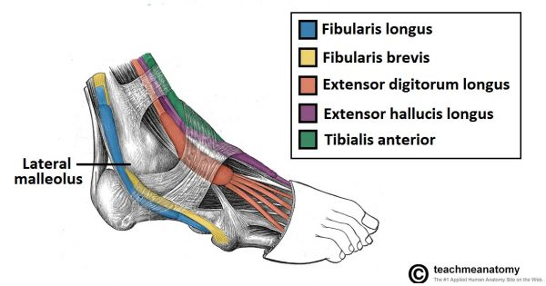
– Lateral view of the tendons of the foot

Slide 181
Fibularis Tertius
The fibularis tertius muscles arises from the most inferior part of the EDL. It is not present in all individuals, and is considered by some texts as a part of the extensor digitorum longus.

Slide 182
Attachments: Originates with the extensor digitorum longus from the medial surface of the fibula. The tendon descends with the EDL, until they reach the dorsal surface of the foot. The fibularis tertius tendon then diverges and attaches to metatarsal V.

Slide 183
Actions: Eversion and dorsiflexion of the foot.
Innervation: Deep fibular nerve.

Slide 184
Clinical Relevance: Footdrop
Footdrop is a clinical sign indicating paralysis of the muscles in the anterior compartment of the leg. It typically occurs as a consequence of damage to the common fibular (peroneal) nerve – from which the deep fibular nerve arises.

Slide 185
In footdrop, the muscles in the anterior compartment are paralysed. The unopposed pull of the muscles in the posterior leg produce permanent plantarflexion.

Slide 186
This can interfere with walking – as the affected limb can drag along the ground. To circumvent this, the patient can flick the foot outwards while walking – known as an ‘eversion flick

Slide 187
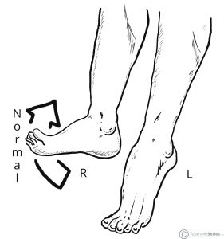
– Left footdrop. This can occur following common fibular or deep fibular nerve palsy

Slide 188
Muscles in the Lateral Compartments of the Leg
There are two muscles in the lateral compartment of the leg; the fibularis longus and brevis (also known as peroneal longus and brevis).

Slide 189
The common function of the muscles is eversion – turning the sole of the foot outwards. They are both innervated by the superficial fibular nerve.

Slide 190
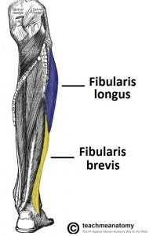
Fibularis Longus

Slide 191
The fibularis longus is the larger and more superficial muscle within the compartment

Slide 192
Attachments
The fibularis longus originates from the superior and lateral surface of the fibula and the lateral tibial condyle.
The fibres converge into a tendon, which descends into the foot, posterior to the lateral malleolus.

Slide 193
The tendon crosses under the foot, and attaches to the bones on the medial side, namely the medial cuneiform and base of metatarsal I.
Actions: Eversion and plantarflexion of the foot. Also supports the lateral and transverse arches of the foot.
Innervation: Superficial fibular (peroneal) nerve, L4-S1.

Slide 194
Fibularis Brevis
The fibularis brevis muscles is deeper and shorter than the fibularis longus.
Attachments:
Originates from the inferolateral surface of the fibular shaft. The muscle belly forms a tendon, which descends with the fibularis longus into the foot.

Slide 195
It travels posteriorly to the lateral malleolus, passing over the calcaneus and the cuboidal bones.
The tendon then attaches to a tubercle on metatarsal V.
Actions: Eversion of the foot.
Innervation: Superficial fibular (peroneal) nerve, L4-S1

Slide 197
Clinical Relevance: Locating the Common Fibular Nerve
The common fibular nerve can be a difficult structure to identify. However, it can be located using the fibularis longus as an anatomical landmark.
There is a small space between the parts of the fibularis longus that originate from the head of the fibula, and the neck of the fibula. The common fibular nerve passes through this gap, and is easily identified.
After passing through the gap, the nerve terminates by bifurcating into two terminal branches; the deep and superficial fibular nerve.

Slide 198
Muscles in the Posterior Compartment of the Leg
The posterior compartment of the leg contains seven muscles, organised into two layers – superficial and deep. The two layers are separated by a band of fascia

Slide 199
The posterior leg is the largest of the three compartments. Collectively, the muscles in this area plantarflex and invert the foot. They are innervated by the tibial nerve, a terminal branch of the sciatic nerve.

Slide 200
Superficial Muscles
The superficial muscles form the characteristic ‘calf’ shape of the posterior leg. They all insert into the calcaneus of the foot (the heel bone), via the calcaneal tendon. The calcaneal reflex tests spinal roots S1-S2.

Slide 201
To minimise friction during movement, there are two bursae (fluid filled sacs) associated with the calcaneal tendon:
Subcutaneous calcaneal bursa – lies between the skin and the calcaneal tendon.
Deep bursa of the calcaneal tendon – lies between the tendon and the calcaneus.

Slide 202
Gastrocnemius
The gastrocnemius is the most superficial of all the muscles in the posterior leg. It has two heads – medial and lateral, which converge to form a single muscle belly.

Slide 203
Attachments: The lateral head originates from the lateral femoral condyle, and medial head from the medial femoral condyle. The fibres converge, and form a single muscle belly. In the lower part of the leg, the muscle belly combines with the soleus to from the calcaneal tendon, with inserts onto the calcaneus (the heel bone).

Slide 204
Actions: It plantarflexes at the ankle joint, and because it crosses the knee, it is a flexor there.
Innervation: Tibial nerve.

Slide 205
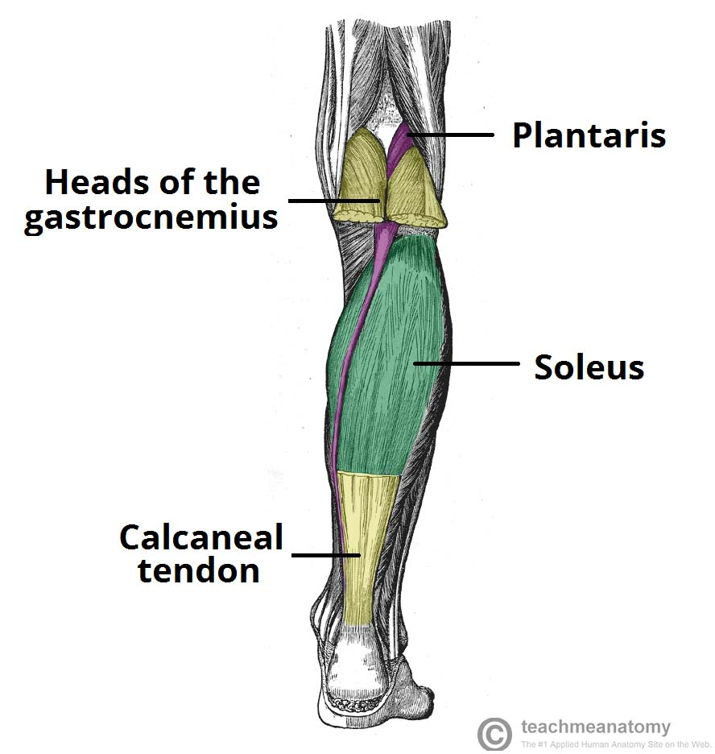

Slide 206
Plantaris
The plantaris is a small muscle with a long tendon, which can be mistaken for a nerve as it descends down the leg. It is absent in 10% of people.

Slide 207
Attachments: Originates from the lateral supracondylar line of the femur. The muscle descends medially, condensing into a tendon that runs down the leg, between the gastrocnemius and soleus. The tendon blends with the calcaneal tendon.

Slide 208
Actions: It plantarflexes at the ankle joint, and because it crosses the knee, it is a flexor there. It is not a vital muscle for these movements.
Innervation: Tibial nerve.

Slide 209
Soleus
The soleus is located deep to the gastrocnemius. It is large and flat, named soleus due to its resemblance of a sole – a flat fish.

Slide 210
Attachments: Originates from the soleal line of the tibia and proximal fibular area. The muscle narrows in the lower part of the leg, and joins the calcaneal tendon.
Actions: Plantarflexes the foot at the ankle joint.
Innervation: Tibial Nerve.

Slide 211
Clinical Relevance: Ruptured Calcaneal Tendon
Rupture of the calcaneal tendon refers to a partial or complete tear of the tendon. It is more likely to occur in people with a history of calcaneal tendinitis (chronic inflammation of the tendon).

Slide 212
The injury is usually sustained during forceful plantarflexion of the foot. The patient will be unable to plantarflex the foot against resistance, and the affected foot will be permanently dorsiflexed. The soleus and gastrocnemius can contract to form a lump in the calf region.
Treatment of a ruptured calcaneal tendon is usually non-surgical, except in those with active lifestyles.

Slide 213
Deep Muscles
There are four muscles in the deep compartment of the posterior leg. One muscle, the popliteus, acts only on the knee joint. The remaining three muscles (tibialis posterior, flexor hallucis longus and flexor digitorum longus) act on the ankle and foot.

Slide 214
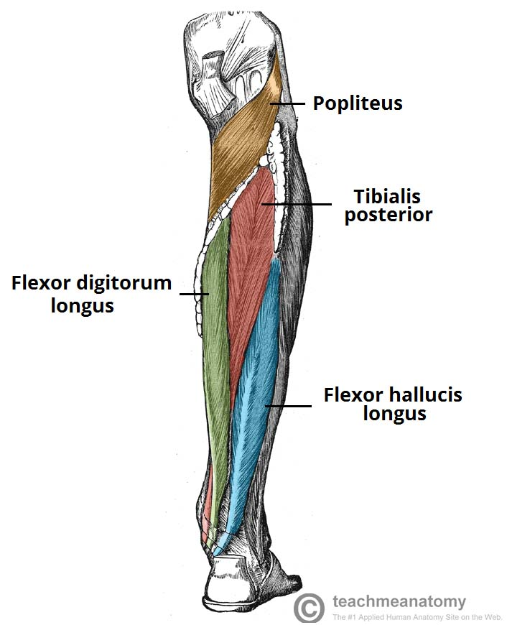
Popliteus
– Muscles in the deep layer of the posterior leg

Slide 215
The popliteus is located superiorly in the leg. It lies behind the knee joint, forming the base of the popliteal fossa.

Slide 216
There is a bursa (fluid filled sac) that lies between the popliteal tendon and the posterior surface of the knee joint. It is called the popliteus bursa.

Slide 217
Attachments: Originates from the lateral condyle of the femur and the posterior horn of the lateral meniscus. From there, it runs inferomedially towards the tibia and inserts above the origin of the soleus muscle.
Actions: Laterally rotates the femur on the tibia – ‘unlocking’ the knee joint so that flexion can occur.
Innervation: Tibial nerve.

Slide 218
Tibialis Posterior
The tibialis posterior is the deepest out of the four muscles. It lies between the flexor digitorum longus and the flexor hallucis longus.

Slide 219
Attachments: Originates from the interosseous membrane between the tibia and fibula, and posterior surfaces of the two bones. The tendon enters the foot posterior to the medial malleolus, and attaches to the plantar surfaces of the medial tarsal bones.

Slide 220
Actions: Inverts and plantarflexes the foot, maintains the medial arch of the foot.
Innervation: Tibial nerve.

Slide 221
Flexor Digitorum Longus
The FDL is (surprisingly) a smaller muscle than the flexor hallucis longus. It is located medially in the posterior leg.
Attachments: Originates from the medial surface of the tibia, attaches to the plantar surfaces of the lateral four digits.
Actions: Flexes the lateral four toes.
Innervation: Tibial nerve.

Slide 222
Flexor Hallucis Longus
The flexor hallucis longus muscle is found on the lateral side of leg. This is slightly counter-intuitive, as it is opposite the great toe, which it acts on.
Attachments: Originates from the posterior surface of the fibula, attaches to the plantar surface of the phalanx of the great toe.
Actions: Flexes the great toe.
Innervation: Tibial nerve.

Slide 223
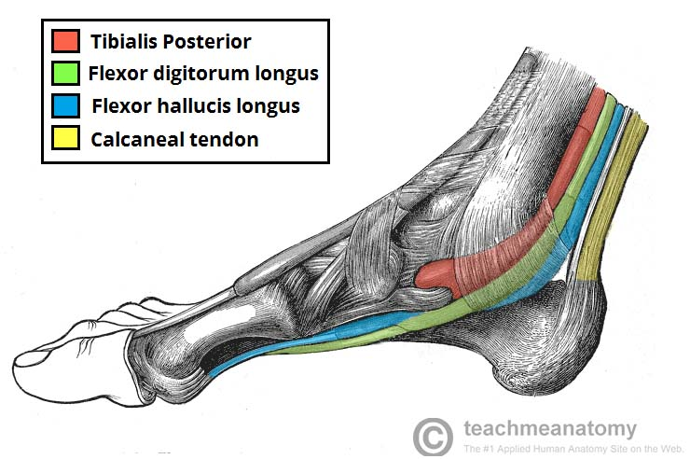
Medial view of the tendons of the posterior leg

Slide 224
Muscles of the Foot
The muscles acting on the foot can be divided into two distinct groups; extrinsic and intrinsic muscles.

Slide 225
The extrinsic muscles arise from the anterior, posterior and lateral compartments of the leg. They are mainly responsible for actions such as eversion, inversion, plantarflexion and dorsiflexion of the foot.

Slide 226
Dorsal Aspect
Whilst many of the extrinsic muscles attach to the dorsum of the foot, there are only two intrinsic muscles located in this compartment – the extensor digitorum brevis, and the extensor hallucis brevis.

Slide 227
The intrinsic muscles are located within the foot and are responsible for the fine motor actions of the foot, for example movement of individual digits.

Slide 228
They are mainly responsible for assisting some of the extrinsic muscles in their actions. Both muscles are innervated by the deep fibular nerve.

Slide 229
Extensor Digitorum Brevis
The extensor digitorum brevis muscle lies deep to the tendon of the extensor digitorum longus.
Attachments: Originates from the calcaneus, the interosseous talocalcaneal ligament and the inferior extensor retinaculum. It attaches to the long extensor tendons of the four lateral digits.

Slide 230
Actions: Aids the extensor digitorum longus in extending the lateral four toes at the metatarsophalangeal and interphalangeal joints.
Innervation: Deep fibular nerve.

Slide 231
Extensor Hallucis Brevis
The extensor hallucis brevis muscle is medial to extensor digitorum longus and lateral to extensor hallucis longus.

Slide 232
Attachments: Originates from the calcaneus, the interosseous talocalcaneal ligament and the inferior extensor retinaculum. It attaches to the base of the proximal phalanx of the great toe.

Slide 233
Actions: Aids the extensor hallucis longus in extending the great toe at the metatarsophalangeal joint.
Innervation: Deep fibular nerve.

Slide 234
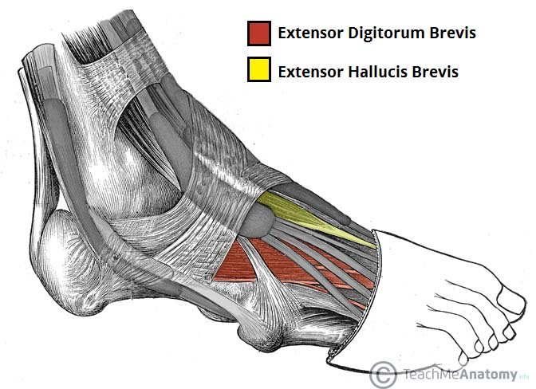
The dorsal layer of foot muscles.

Slide 235
Plantar Aspect
There are 10 intrinsic muscles located in the sole of the foot. They act collectively to stabilise the arches of the foot, and individually to control movement of the digits

Slide 236
All the muscles are innervated either by the medial plantar nerve or the lateral plantar nerve, which are both branches of the tibial nerve.
The muscles of the plantar aspect are described in four layers (superficial to deep).

Slide 237
First Layer
The first layer of muscles is the most superficial to the sole, and is located immediately underneath the plantar fascia. There are three muscles in this layer.

Slide 238
Abductor Hallucis
The abductor hallucis muscle is located on the medial side of the sole, where it contributes to a small soft tissue bulge.

Slide 239
Attachments: Originates from the medial tubercle of the calcaneus, the flexor retinaculum and the plantar aponeurosis. It attaches to the medial base of the proximal phalanx of the great toe.
Actions: Abducts and flexes the great toe.
Innervation: Medial plantar nerve.

Slide 240
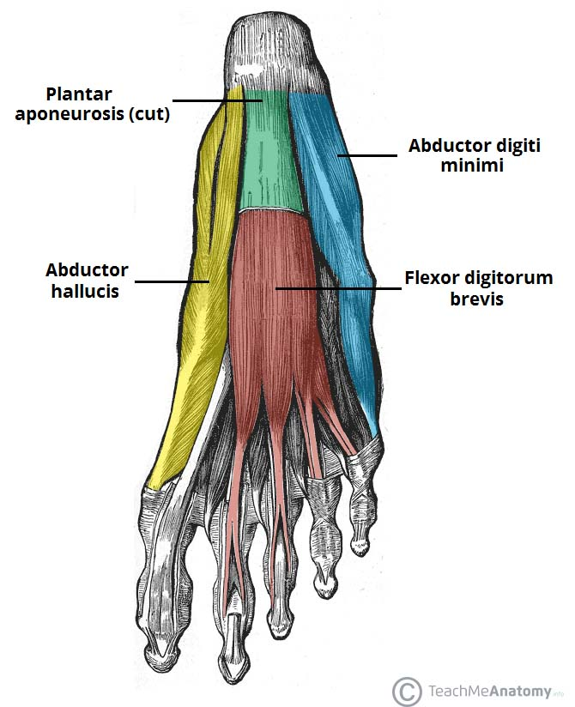

Slide 241
Flexor Digitorum Brevis
The flexor digitorum brevis muscle is located laterally to the abductor hallucis. It sits in the centre of the sole, sandwiched between the plantar aponeurosis and the tendons of flexor digitorum longus.

Slide 242
Attachments: Originates from the medial tubercle of the calcaneus and the plantar aponeurosis. It attaches to the middle phalanges of the lateral four digits.
Actions: Flexes the lateral four digits at the proximal interphalangeal joints.
Innervation: Medial plantar nerve

Slide 243
Abductor Digiti Minimi
The abductor digiti minimi muscle is located on the lateral side of the foot. It is homologous with the abductor digiti minimi of the hand.

Slide 244
Attachments: Originates from the medial and lateral tubercles of the calcaneus and the plantar aponeurosis. It attaches to the lateral base of the proximal phalanx of the 5th digit.
Actions: Abducts and flexes the 5th digit.
Innervation: Lateral plantar nerve

Slide 245
Second Layer
The second layer contains two muscles – the quadratus plantae, and the lumbricals. In addition, the tendons of the flexor digitorum longus (an extrinsic muscle of the foot) pass through this layer.

Slide 246
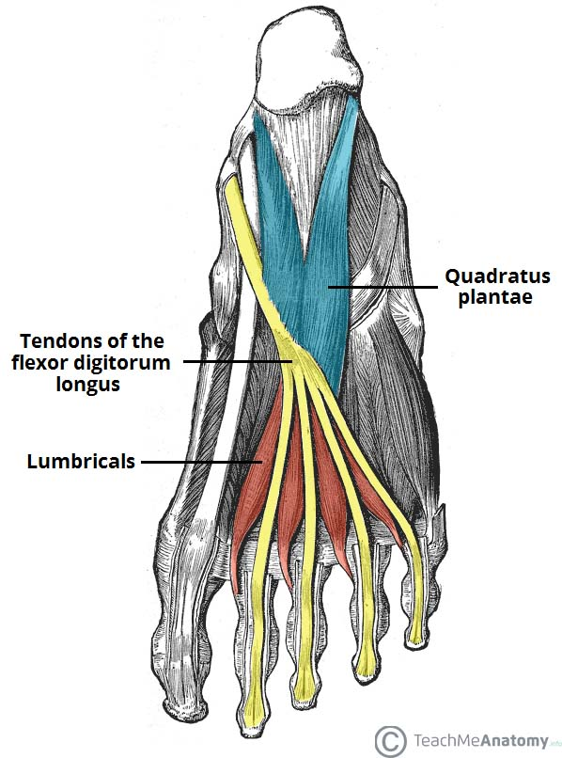
Quadratus Plantae

Slide 247
The quadratus plantae muscle is located superior to the flexor digitorum longus tendons. It is separated from the first layer of muscles by the lateral plantar vessels and nerve.

Slide 248
Attachments: Originates from the medial and lateral plantar surface of the calcaneus. It attaches to the tendons of flexor digitorum longus.
Actions: Assists flexor digitorum longus in flexing the lateral four digits.
Innervation: Lateral plantar nerve.

Slide 249
Lumbricals
There are four lumbrical muscles in the foot. They are each located medial to their respective tendon of the flexor digitorum longus.

Slide 250
Attachments: Originates from the tendons of flexor digitorum longus. Attaches to the extensor hoods of the lateral four digits.
Actions: Flexes at the metatarsophalangeal joints, while extending the interphalangeal joints.

Slide 251
Innervation: The most medial lumbrical is innervated by the medial plantar nerve. The remaining three are innervated by the lateral plantar nerve.

Slide 252
Third Layer
The third layer contains three muscles. The flexor hallucis brevis and adductor hallucis are associated with movements of the great toe. The remaining muscle, the flexor digiti minimi brevis, moves the little toe

Slide 253
Flexor Hallucis Brevis
The flexor hallucis brevis muscle is located on the medial side of the foot. It originates from two places on the sole of the foot.

Slide 254
Attachments: Originates from the plantar surfaces of the cuboid and lateral cuneiforms, and from the tendon of the posterior tibialis tendon. Attaches to the base of the proximal phalanx of the great toe.

Slide 255
Actions: Flexes the proximal phalanx of the great toe at the metatarsophalangeal joint.
Innervation: Medial plantar nerve.

Slide 256
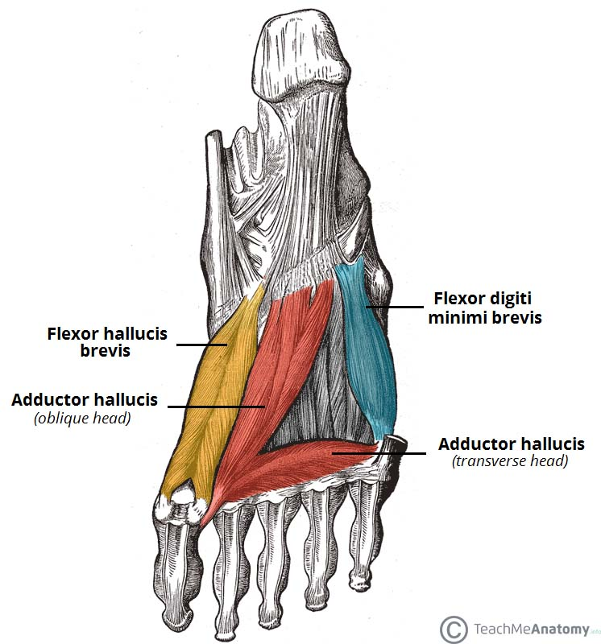

Slide 257
Adductor Hallucis
The adductor hallucis muscle is located laterally to the flexor hallucis brevis. It consists of an oblique and transverse head.

Slide 258
Attachments: The oblique head originates from the bases of the 2nd, 3rd and 4th metatarsals. The transverse head originates from the plantar ligaments of the metatarsophalangeal joints. Both heads attach to the lateral base of the proximal phalanx of the great toe.

Slide 259
Actions: Adduct the great toe. Assists in forming the transverse arch of the foot.
Innervation: Deep branch of lateral plantar nerve

Slide 260
Flexor Digiti Minimi Brevis
The flexor digiti minimi brevis muscle is located on the lateral side of the foot, underneath the metatarsal of the little toe. It resembles the interossei in structure.

Slide 261
Attachments: Originates from the base of the fifth metatarsal. Attaches to the base of the proximal phalanx of the fifth digit.
Actions: Flexes the proximal phalanx of the fifth digit.
Innervation: Superficial branch of lateral plantar nerve.

Slide 262
Fourth Layer
The plantar and dorsal interossei comprise the fourth and final plantar muscle layer. The plantar interossei have a unipennate morphology, while the dorsal interossei are bipennate.

Slide 263
Plantar Interossei
There are three plantar interossei, which are located between the metatarsals. Each arises from a single metatarsal.

Slide 264
Attachments: Originates from the medial side of metatarsals three to five. Attaches to the medial sides of the phalanges of digits three to five.

Slide 265
Actions: Adduct digits three to five and flex the metatarsophalangeal joints.
Innervation: Lateral plantar nerve

Slide 266
Dorsal Interossei
There are four dorsal interossei, which are located between the metatarsals. Each arises from two metatarsals.

Slide 267
Attachments: Originates from the sides of metatarsals one to five. The first muscle attaches to the medial side of the proximal phalanx of the second digit. The second to fourth interossei attach to the lateral sides of the proximal phalanxes of digits two to four.

Slide 268
Actions: Abduct digits two to four and flex the metatarsophalangeal joints.
Innervation: Lateral plantar nerve.

Slide 269
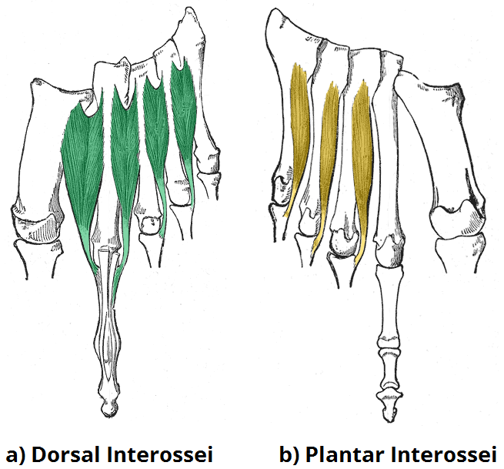
. Note the unipennate shape of the plantar interossei, and the bipennate shape of the dorsal interossei

Slide 270
End

